Slide 1
TECHNOLOGY360

Slide 2
WHO WE ARE
We're Creative Designers & Strategy players with a combined experience of over 10+years
We've worked with companies across industries through the constantly evolving digital platforms.
We specialize in: Web Designing+ Digital Marketing + App Designing+ Email Marketing + Data scraping with
a knack for unique strategies
TECHNOLOGY360

Slide 3
ABOUT US
As a Digital Marketer, I'm very interested in exploring new media formats combined with swift engaging content to create perfectly timed virality. We can create a high impact on brands in both organic and paid. With integrated knowledge from different business verticals, we can reach client goals with an awesome campaign.
With the Help of Eye-catching designing team for Both Web Sites and Mobile Applications, We design the client's imagination. Our Best Working skills follow the technical terms to get audience engagement. We had a "Do it myself" attitude for when things get intense. We believe that 'Customer is our God' Needs to satisfy them every minute.
“Technology360, We started our Journey in 2017 with 1. Started from the bottom, Now serving with 15members of strong team to 50+ Clients in different business categories world wide”..
TECHNOLOGY360

Slide 4
WHAT WE BELIEVE IN?
We think digital intrinsically. It is in our DNA.
But as marketers, we approach it holistically
WHAT’s OUR APPROACH ?
Understanding the client goals
Understanding the competition
Understanding the business
Breaking the clutter with the right mix
TECHNOLOGY360

Slide 5
HOW WE PLAY MIND GAME
| STRATEGY | DESIGN | MARKETING | DATA | GROW
Analytical
Creative
Leads Driven
Crazy
Strategy Player
Professional
Business Booster
TECHNOLOGY360

Slide 6
IF YOU WANT TO GROW
YOUR BRAND
WE LIKE TO
EXPERIMENT
WITH Best Strategies and Technologies too
TECHNOLOGY360

Slide 7
AND WHY WOULD YOU WANTUS ?
WE PLAY WITH TRENDS
Being a strong Experience across various digital tools We take your brand to the next level. We love creating unique concepts after thoroughly .analyzing the client goals and competitors.
WE LIVE YOUR DREAM
Our Experienced designers creates eye catching design, which reach your dream platform to live your business, Our best interface attracts the normal users to be a potential customers. We Don’t just talk, Our Designs speak.
SPECIFIC WORK APPROAH
Being a professional we explain the possibilities to reach the client requirements. Client can choose any single or multiple paths.
YOU MAY HAVE SMALL TEAM, DO YOU NEED IT ?
Yes, We are small but We promote you globally. If you are paying 2-3 lakhs to your marketing team it’s time to switch to us. We have a variable options in your budget.
WE HAVE PARTNERS, NOT CLIENTS
TECHNOLOGY360

Slide 8
OUR SERVICES
CORE SERVICES
SELECTIVE SERVICES
WEB DESIGNING
LOGO/GRAPHIC DESIGNING
APP DEVELOPMENT
BRANDING
DIGITAL MARKETING
LEAD GENERATIONS
EMAIL MARKETING
DOMAIN & HOSTING
DATA SCRAPING
MAINTENANCE SERVICES
TECHNOLOGY360

Slide 9
OUR WORKS
TECHNOLOGY360

Slide 10
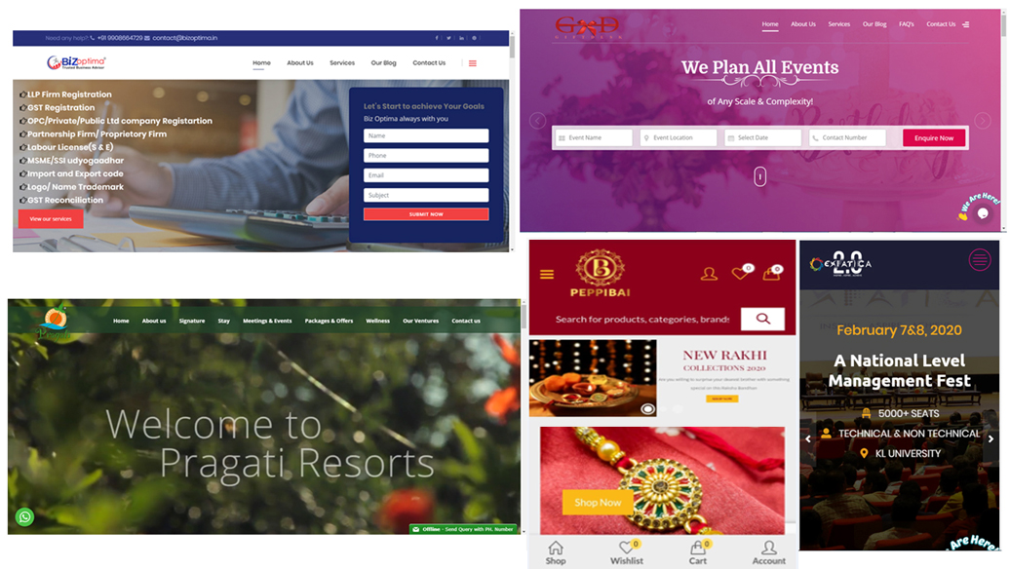
OUR DESIGNS
FEW OF OUR EYE CATCHING DESIGNS..CONNECT US TO CHECK MORE
TECHNOLOGY360

Slide 11
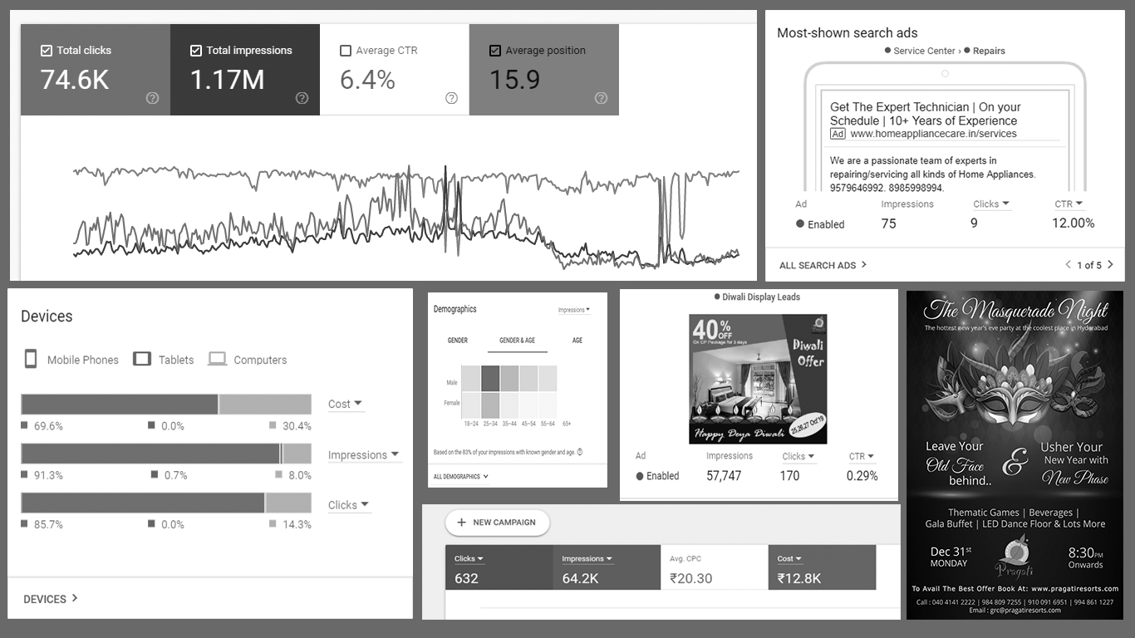
SEO, PAID AD’s & SOCIAL MEDIA
FEW OF OUR DIGITAL MARKETING STRATEGIES..CONNECT US TO CHECK MORE..
TECHNOLOGY360

Slide 12
Achievements
KEYWORDS OPTIMIZED : 5,215
SOCIAL MEDIA POSTS: 12,005
IMPRESSIONS : 35,23,120
PRODUCTS OPTIMIZED: 7,619
PAGE VIEWS GENERATED :20,00,135
TOTAL CLIENTS SERVED: 57
BACK LINKS GENERATED : 39,915
ORGANIC & PAID
LEADS GENERATED: 22,419
ACTIVE CLIENTS: 15+
EMAILS DELIEVERED: 15,72,153
ADS COVERED: 25,419
REVIEWS GENER-
ATED: 12,000+
BRAND REACHES: 71,12,084
DATA SCRAPED: 10,20,902
YOUTUBE VIEWS: 61,12,041
CONVERSIONS: 11,841
SEARCH ENGINES: 6+
BLOG POSTS: 941
THESE ARE THE FIGURES WE HAVE GENERATED, THESE ARE INCLUDED IN OUR DIRECT & THIRD PARTY CLIENTS.
TECHNOLOGY360

Slide 13
CLIENTS WE WORKED
GIFT DESK
PRAGATI RESORTS
BIZOPTIMA
AVANSA IT
EXPATICA
SALON JOBS
FREEGAMESBOX
PEPPIBAI
SUNCON IT
THE LEARN IT
MY DISCOUNTS
SALON GENIE
THESE ARE BRANDS WE HAVE personally worked on, while Managing our team. This does not include all the brands we have pitched for as A part of Business Development. Currently standing at 50+
TECHNOLOGY360

Slide 14
THAT’s ALL BUDDY
TECHNOLOGY360
“A journey of a thousand miles starts with a single step”
+91 95333 37390
Email: info@technology360.in
www.technology360.in
Reach us at

